Slide 1
Object Oriented Software Development
5. Interfaces, polymorphism and inheritance

Slide 2
Types of interface
The word “interface” has more than one meaning in programming
User interface
  The way in which the user interacts with the program
Programming interface
  The way in which software components in an application interact with each other
We are looking at the latter here, and will look at the former later on
Object Oriented Software Development 5. Interfaces, polymorphism and inheritance
<number>

Slide 3
Interfaces example
InterfaceDemo project
Employee.cs
ITimeSheet.cs
DatabaseTimeSheet.cs
FileTimeSheet.cs
Object Oriented Software Development 5. Interfaces, polymorphism and inheritance
<number>

Slide 4
The interface provided by a component
In previous examples we saw an Employee class which uses a TimeSheet object
Method parameter of type TimeSheet
Within its RecordOvertime method an Employee calls the AddEntry method of the TimeSheet object
Employee only needs to know that the TimeSheet class provides a method of that name, and the signature of the method
Object Oriented Software Development 5. Interfaces, polymorphism and inheritance
<number>

Slide 5
The interface provided by a component
Employee does not need to know anything about how the AddEntry method works
Details are hidden behind the class interface
Details of how AddEntry works could be changed without affecting Employee
If a programmer wants to use the TimeSheet class in another class, only needs to know the class interface
Object Oriented Software Development 5. Interfaces, polymorphism and inheritance
<number>

Slide 6
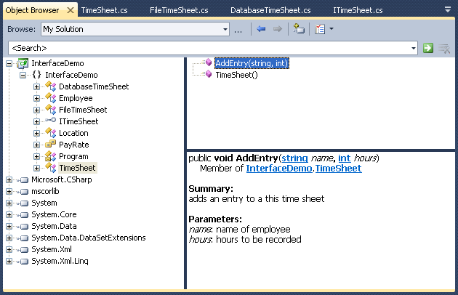
Documentation of interface
Good documentation makes it easy for programmer to understand the interface of a class and how to use it
XML comments
help to make
documentation
useful
Object Oriented Software Development 5. Interfaces, polymorphism and inheritance
<number>

Slide 7
Programming to an interface
Employee doesn’t care about the details of a TimeSheet, just the interface
Make this explicit by defining the interface as an item in its own right
Convention (in .NET anyway) is to name the interface with an I - ITimeSheet
Refer to the interface name, not the actual object type
Object Oriented Software Development 5. Interfaces, polymorphism and inheritance
<number>

Slide 8
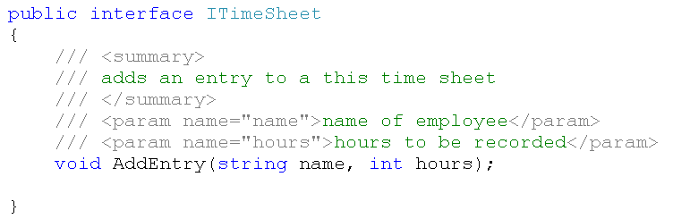
Defining an interface
Interface definition
Use ITimeSheet as reference type
method is empty – no code block
Object Oriented Software Development 5. Interfaces, polymorphism and inheritance
<number>

Slide 9
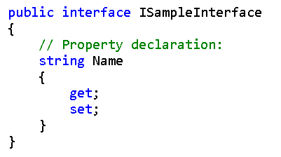
Defining properties in an interface
A property is defined in an interface by specifying the property type, and empty get and/or set declarations
Object Oriented Software Development 5. Interfaces, polymorphism and inheritance
<number>

Slide 10
Rules for interfaces
Interfaces can contain:
  Methods – declaration only
  Properties – declaration only
  Events
Interfaces can’t contain
  Instance variables
  Constants
  Constructors
  Static members
  Access modifiers
Object Oriented Software Development 5. Interfaces, polymorphism and inheritance
<number>

Slide 11
Implementing an interface
Interface doesn’t actually do anything – need to create class which implements the interface
Must provide implementation for all members (methods/properties) defined in the interface
Class which implements ITimeSheet must (at least) provide a method called AddEntry with the signature defined in ITimeSheet
Must provide code block for method
Object Oriented Software Development 5. Interfaces, polymorphism and inheritance
<number>

Slide 12
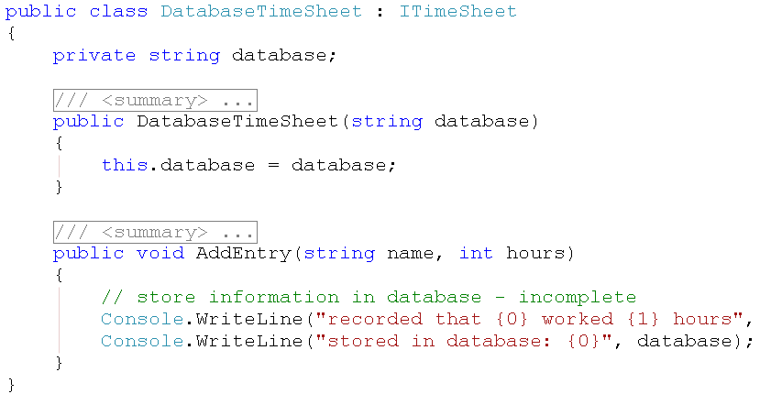
Implementing an interface
“implements ITimeSheet”
class can have fields, constructors, etc
method has code block
Object Oriented Software Development 5. Interfaces, polymorphism and inheritance
<number>

Slide 13
Implementing multiple interfaces
A class can implement more than one interface
Class must provide implementations of all the methods declared in all the interfaces it implements
Object Oriented Software Development 5. Interfaces, polymorphism and inheritance
<number>

Slide 14
Interface as a contract
A contract is an agreement
By implementing an interface, a class agrees that it will provide the defined members
This class can then be used by other classes with confidence because they know that it has agreed to provide the required members
Employee can use any class which implements ITimeSheet in the knowledge that it will have AddEntry method
Object Oriented Software Development 5. Interfaces, polymorphism and inheritance
<number>

Slide 15
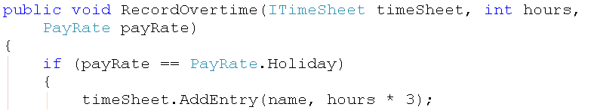

Reference and runtime types
Method definition in Employee
Method call in Program
reference type is ITimeSheet
create DatabaseTimeSheet object at runtime
can call AddEntry because we know runtime type must have agreed to provide this method
pass DatabaseTimeSheet object as parameter at runtime – implements ITimeSheet
Object Oriented Software Development 5. Interfaces, polymorphism and inheritance
<number>

Slide 16
Interface polymorphism
Polymorphism means “many forms”
Reference to an interface type can point, as the program runs, to any object of a type which implements that interface
Can pass any object which implements ITimeSheet as a parameter to RecordOvertime method in Employee
Can declare a variable of type ITimeSheet and set it to an object of any type which implements ITimeSheet
Object Oriented Software Development 5. Interfaces, polymorphism and inheritance
<number>

Slide 17
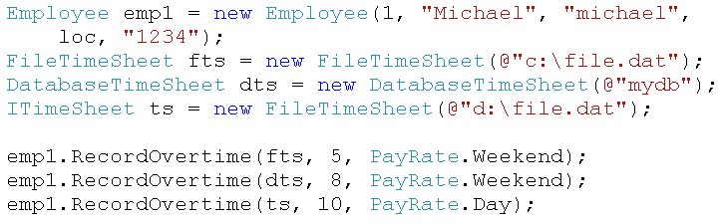
Interface polymorphism
interface as reference type
alternative implementations of a time sheet
can pass any of these objects at runtime when parameter type is ITimeSheet
interface can be implemented by class or struct
Object Oriented Software Development 5. Interfaces, polymorphism and inheritance
<number>

Slide 18
Advantages of using interfaces
Application code written based on the functionality guaranteed by interface rather than functionality of a particular class
Reduces code dependencies
Code standardisation
Easier to write reusable code
Interfaces are used extensively in the .NET Framework library
Object Oriented Software Development 5. Interfaces, polymorphism and inheritance
<number>

Slide 19
Inheritance
Often have classes which have some common features
  e.g. different kinds of employee – SalariedEmployee, HourlyPaidEmployee
These are more specific versions of Employee
  “is-a” relationship – SalariedEmployee is a type of Employee
  They will share some common features
  Each will require some specific features
Object Oriented Software Development 5. Interfaces, polymorphism and inheritance
<number>

Slide 20
Inheritance example
InheritanceDemo project
Employee.cs
SalariedEmployee.cs
HourlyPaidEmployee.cs
Object Oriented Software Development 5. Interfaces, polymorphism and inheritance
<number>

Slide 21
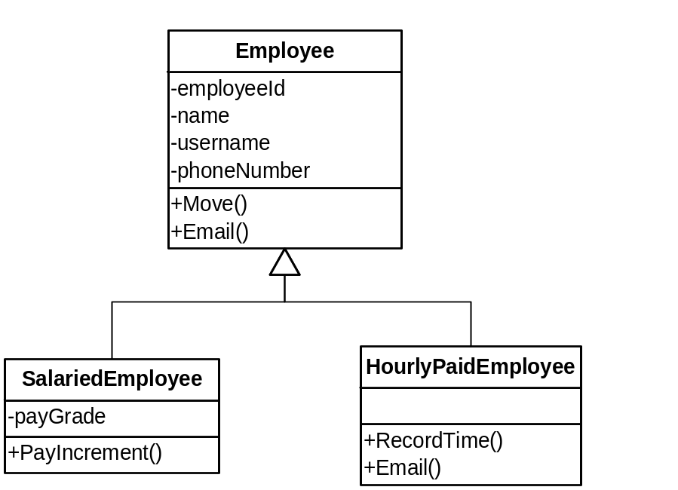

Inheritance hierarchy
generalised
base class or
superclass
inheritance relationships
derived classes
or subclasses
specialised
inherits all fields and methods from base class and adds payGrade field and PayIncrement method
inherits all fields and methods from base class, adds RecordTime method and provides specialised version of Email method
Object Oriented Software Development 5. Interfaces, polymorphism and inheritance
<number>

Slide 22
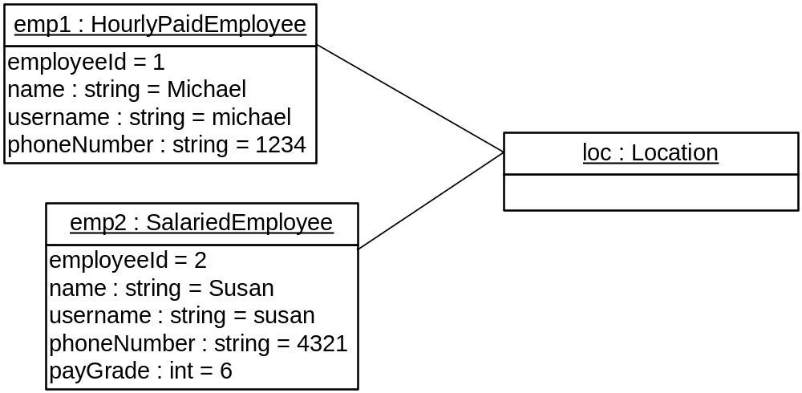
Inheritance - object diagram
Instance of subclass has all fields defined in subclass and all fields defined in superclass
No actual instance of superclass at runtime
Object Oriented Software Development 5. Interfaces, polymorphism and inheritance
<number>

Slide 23
Inheritance hierarchies
A class can have many subclasses
A class can only have one superclass
  No multiple inheritance (in C# anyway)
  Compare this with implementing interfaces
Subclass can itself have subclasses
Subclass can:
  Inherit members of superclass
  Add new members
  Override members of superclass
Object Oriented Software Development 5. Interfaces, polymorphism and inheritance
<number>

Slide 24
Advantages of using inheritance
Reduced code duplication
Increased code reuse
Models real-world situations
Polymorphism
Inheritance is used extensively in the .NET Framework library
Object Oriented Software Development 5. Interfaces, polymorphism and inheritance
<number>

Slide 25
.NET base types
All .NET types are derived from System.Object class
All .NET value types are derived from System.ValueType class
System.ValueType is a subclass of System.Object
But, inheritance from structs is not allowed
Object Oriented Software Development 5. Interfaces, polymorphism and inheritance
<number>

Slide 26
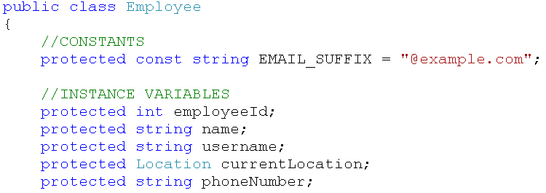
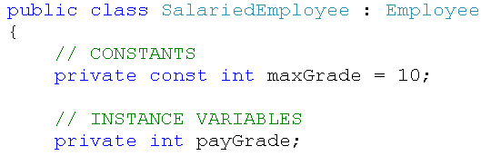
Implementing inheritance
protected – means variables are accessible from subclasses, but not from other classes
SalariedEmployee inherits all of these
“extends Employee”
also define public PayGrade property, other properties inherited
Object Oriented Software Development 5. Interfaces, polymorphism and inheritance
<number>

Slide 27
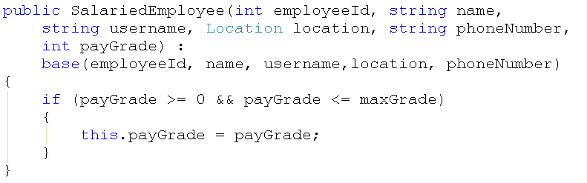
Subclass constructor
Call base class constructor to do initialisation of inherited fields
  Only need to write code for specific subclass initialisation
Object Oriented Software Development 5. Interfaces, polymorphism and inheritance
<number>

Slide 28
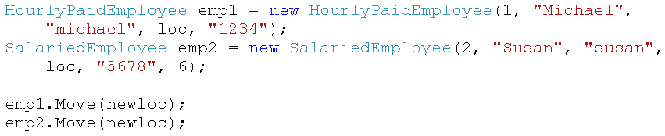
Inherited methods
SalariedEmployee and HourlyPaidEmployee both inherit Move method from Employee
Can call Move method on instance of subclass
Object Oriented Software Development 5. Interfaces, polymorphism and inheritance
<number>

Slide 29

Added methods
HourlyPaidEmployee has additional method RecordTime, which is not in Employee
SalariedEmployee does not have this method
gives compiler error – emp2 is an
instance of SalariedEmployee
Object Oriented Software Development 5. Interfaces, polymorphism and inheritance
<number>

Slide 30
Overriding a method
HourlyPaidEmployee has a specialised version of the Email method
Constructs email address in a way which is specific to this type of employee
Need to override the Email method
Object Oriented Software Development 5. Interfaces, polymorphism and inheritance
<number>

Slide 31
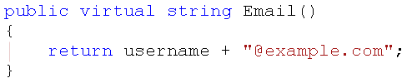


Overriding a method
Declare method as virtual in base class
Declare method as override in subclass
runs method defined in HourlyPaidEmployee
runs method defined in Employee
Object Oriented Software Development 5. Interfaces, polymorphism and inheritance
<number>

Slide 32

Abstract classes
It is likely in the example that every employee will be one or other of the specific kinds
Can declare Employee as an abstract class
This means that no instances can be created
Abstract classes are meant to be base classes which provide basic functionality to be inherited by concrete classes
Object Oriented Software Development 5. Interfaces, polymorphism and inheritance
<number>

Slide 33
Sealed classes
If you don’t want a class to be subclassed, you can declare it as a sealed class
Can also define methods as sealed when class is not sealed
Subclasses cannot override sealed methods
Object Oriented Software Development 5. Interfaces, polymorphism and inheritance
<number>

Slide 34
Inheritance polymorphism
Similar to interface polymorphism
Reference to any type can point, as the program runs, to any object of a type which derives from that type
Can pass an instance of any subclass of Employee to AddEmployee method in Department
Can declare a variable of type Employee and set it to refer to an instance of any subclass of Employee
Object Oriented Software Development 5. Interfaces, polymorphism and inheritance
<number>

Slide 35
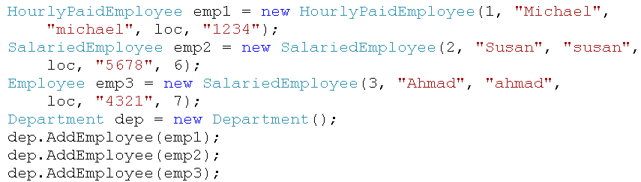
Inheritance polymorphism
base class as reference type
can pass any of these objects at runtime when parameter type is Employee
Object Oriented Software Development 5. Interfaces, polymorphism and inheritance
<number>

Slide 36
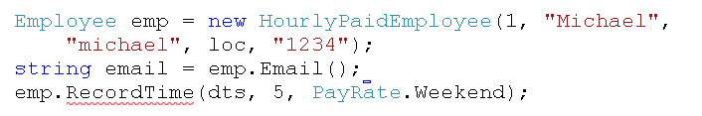
Polymorphism and methods
Example:
  reference type is Employee
  runtime object type is HourlyPaidEmployee
You cannot call a method which is not defined in the object’s reference type
runs method defined in runtime type*
error – method not defined in reference type
*the behaviour is different if you use the word new instead of override in the method
definition – look up the C# reference and try to find out why
Object Oriented Software Development 5. Interfaces, polymorphism and inheritance
<number>

Slide 37
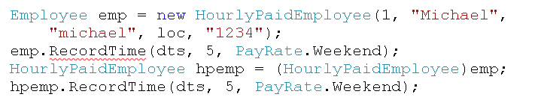
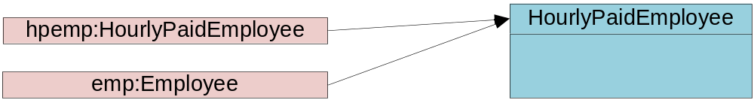
Casting
Solution – cast reference to the runtime type
Object type doesn’t change, only reference type
Cast must be valid
cast operator
new reference to same object
Object Oriented Software Development 5. Interfaces, polymorphism and inheritance
<number>

Slide 38

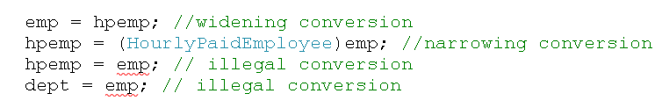
Upcasting and downcasting
Upcast (widening)
  Cast subclass to base class
  Automatic
Downcast (narrowing)
  Cast base class to subclass
  Need explicit cast
Object Oriented Software Development 5. Interfaces, polymorphism and inheritance
<number>

Slide 39

Invalid casts
In previous slide, compiler reported errors for invalid casts
Can have code in which each operation is within the rules, but the result at runtime is invalid
This code compiles, but causes a runtime error – why?
Object Oriented Software Development 5. Interfaces, polymorphism and inheritance
<number>

Slide 40

Prefix and As casting
Previous example was prefix casting
  reliable casting
  reports error (throws exception) if cast is invalid
Can use As casting
  fast casting
  null reference if cast is invalid – no error reported
Specific to .NET!
Object Oriented Software Development 5. Interfaces, polymorphism and inheritance
<number>

Slide 41
When not to use inheritance
Inheritance is one of the cornerstones of object oriented programming
But...
It is not always the right solution for modelling a real-world situation
General rule: “don’t use inheritance to model roles”
Object Oriented Software Development 5. Interfaces, polymorphism and inheritance
<number>

Slide 42

Roles
Could think of the employees example as follows:
Michael is an employee whose role in the company is an hourly paid worker
Susan is an employee whose role is a salaried worker
Object Oriented Software Development 5. Interfaces, polymorphism and inheritance
<number>

Slide 43
Changing roles
What if Susan’s role is to change, and she is to become an hourly paid worker?
We would have to create a whole new HourlyPaidEmployee object to represent her, and remove the existing SalariedEmployee object
No representation of the fact that this is still the same person
Inheritance is a static structure
Object Oriented Software Development 5. Interfaces, polymorphism and inheritance
<number>

Slide 44
A better way - composition
Instead, we could have one object to represent the entity (the employee in this case) and one to represent the role
Combine these to represent Susan
Can change the combination at runtime
Combine Susan’s Employee object with a different role object to change role
Employee could have more than one role
Composition is a dynamic structure
Object Oriented Software Development 5. Interfaces, polymorphism and inheritance
<number>

Slide 45
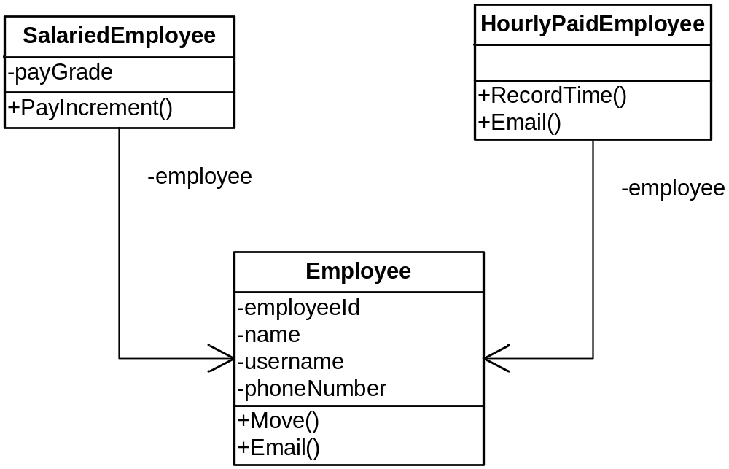
Composition
provides payGrade field and PayIncrement method and delegates other fields and methods to entity
provides RecordTime method and specialised version of Email method and delegates other fields and methods to entity
roles
“has-a” relationships
entities
Object Oriented Software Development 5. Interfaces, polymorphism and inheritance
<number>

Slide 46
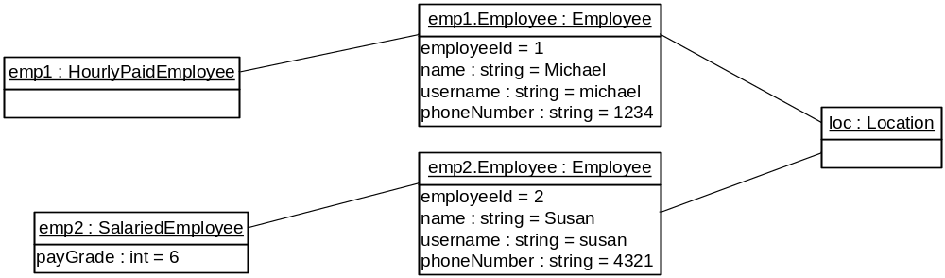
Composition - object diagram
Instances of role and entity exist at runtime
Object Oriented Software Development 5. Interfaces, polymorphism and inheritance
<number>

Slide 47
Composition compared to inheritance
Advantages
  dynamic structure
  models changing roles
  models multiple roles
Disadvantages
  more objects in memory
  code can be harder to understand
  Polymorphism doesn’t work (?)
Which is better in this example?
Object Oriented Software Development 5. Interfaces, polymorphism and inheritance
<number>

Slide 48
Composition example
CompositionDemo
HourlyPaidEmployee.cs
SalariedEmployee.cs
Employee.cs
Object Oriented Software Development 5. Interfaces, polymorphism and inheritance
<number>

Slide 49
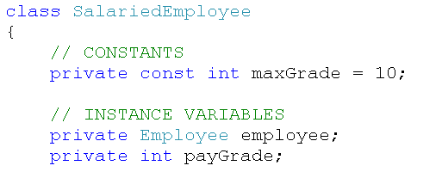
Implementing composition
Employee class unchanged, except methods are not declared virtual
Role classes have instance variable of type Employee
Object Oriented Software Development 5. Interfaces, polymorphism and inheritance
<number>

Slide 50

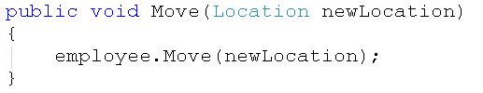
Delegation of properties/methods
Pass a request for EmployeeId property to employee object
Pass a call to Move on to employee object
Object Oriented Software Development 5. Interfaces, polymorphism and inheritance
<number>

Slide 51
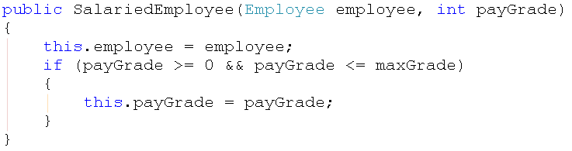
Constructors
Create Employee object then assign it to role object
Object Oriented Software Development 5. Interfaces, polymorphism and inheritance
<number>

Slide 52
Changing role
Create new role object and assign existing Employee object to it
Could assign another Employee to existing role or set it to null
Object Oriented Software Development 5. Interfaces, polymorphism and inheritance
<number>

Slide 53
Polymorphism
How does the example code achieve the advantages of polymorphism even though we have abandoned inheritance?
Object Oriented Software Development 5. Interfaces, polymorphism and inheritance
<number>

Slide 54
Further reading
The following links lead to useful articles on interfaces in C#:
  http://www.c-sharpcorner.com/UploadFile/rmcochran/csharp_interrfaces03052006095933AM/csharp_interrfaces.aspx?ArticleID=cd6a6952-530a-4250-a6d7-54717ef3b345
  http://www.csharp-station.com/Tutorials/Lesson13.aspx
Object Oriented Software Development 5. Interfaces, polymorphism and inheritance
<number>

Slide 55
What’s next?
We will go on to look at structures for holding collections of similar objects, including arrays and the .NET collection types
Some of the concepts introduced in this chapter will be very useful when looking at collections
Object Oriented Software Development 5. Interfaces, polymorphism and inheritance
<number>

